Slide 1
JP DESIGNS
FOR ALL YOUR HOME IMPROVEMENT
NEEDS
352-256-7433
WWW.JAMESPRINGLEDESIGNS.WEBS.COM
Notes:
WWW.JAMESPRINGLEDESIGNS.WEBS.COM

Slide 2
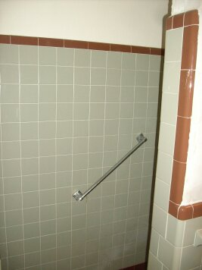
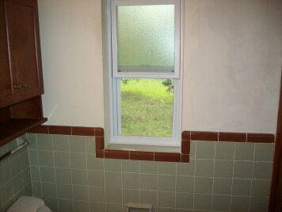
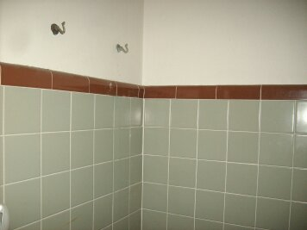
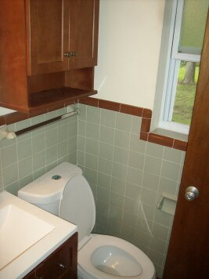
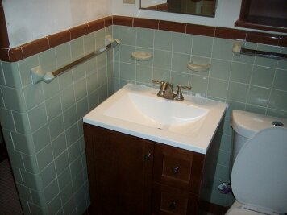
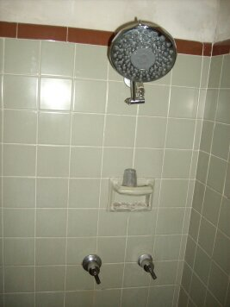
JP DESIGNS
JP DESIGNS
OLD MASTER BATHROOM

Slide 3
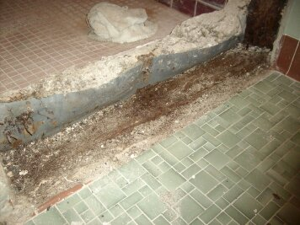
Transformation

Slide 4
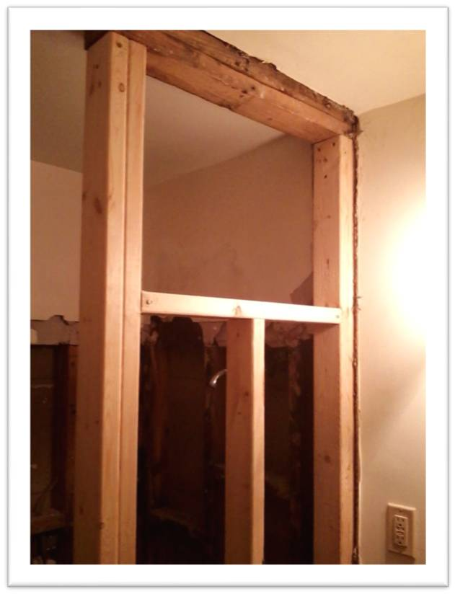
BATHROOM REMODELS

Slide 5
TRANSFORMATION

Slide 6
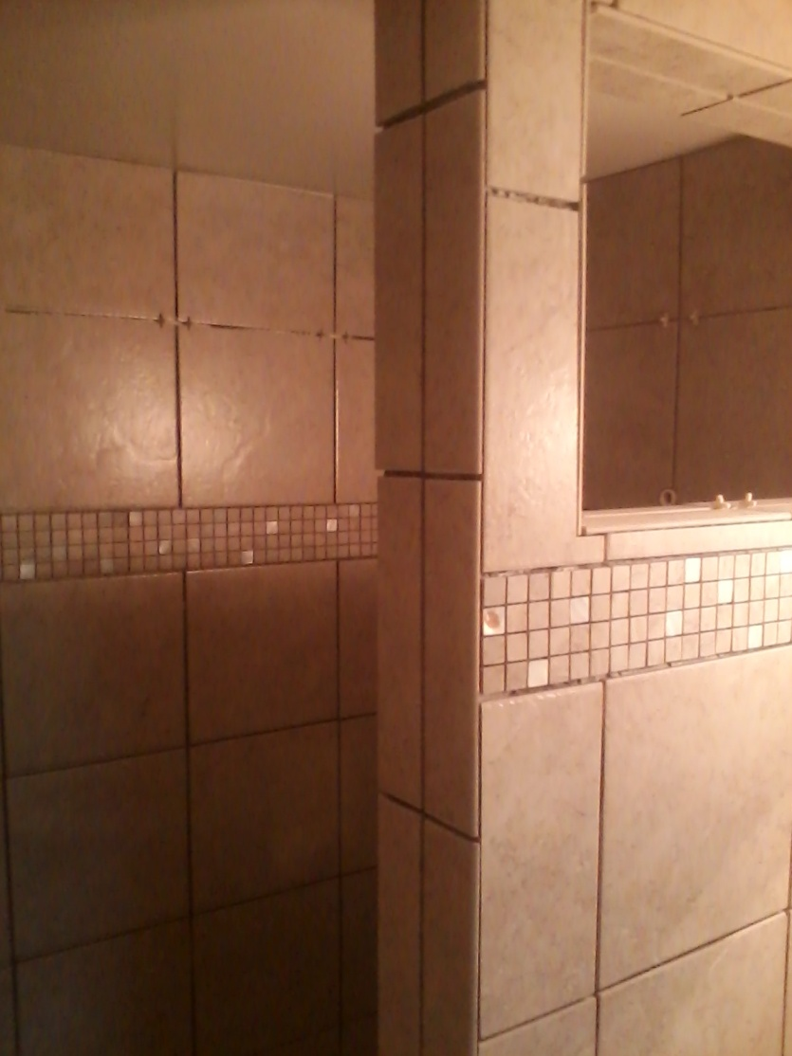
TRANSFORMATION

Slide 7
TRANSFORMATION COMPLETE

Slide 8
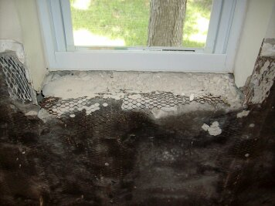
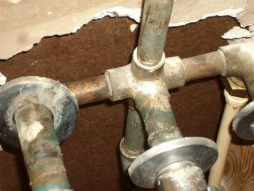
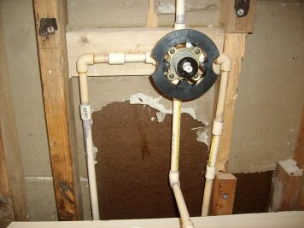
HALL BATH RESTORATION

Slide 9
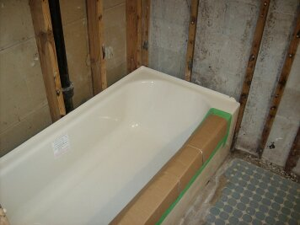
HALL BATH RESTORATION

Slide 10
HALL BATH RESTORATION

Slide 11
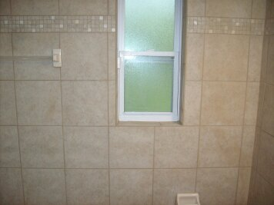
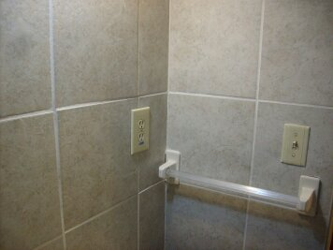
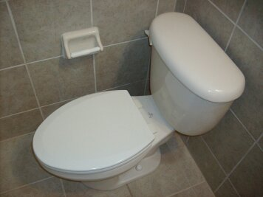
HALL BATH COMPLETE

Slide 12
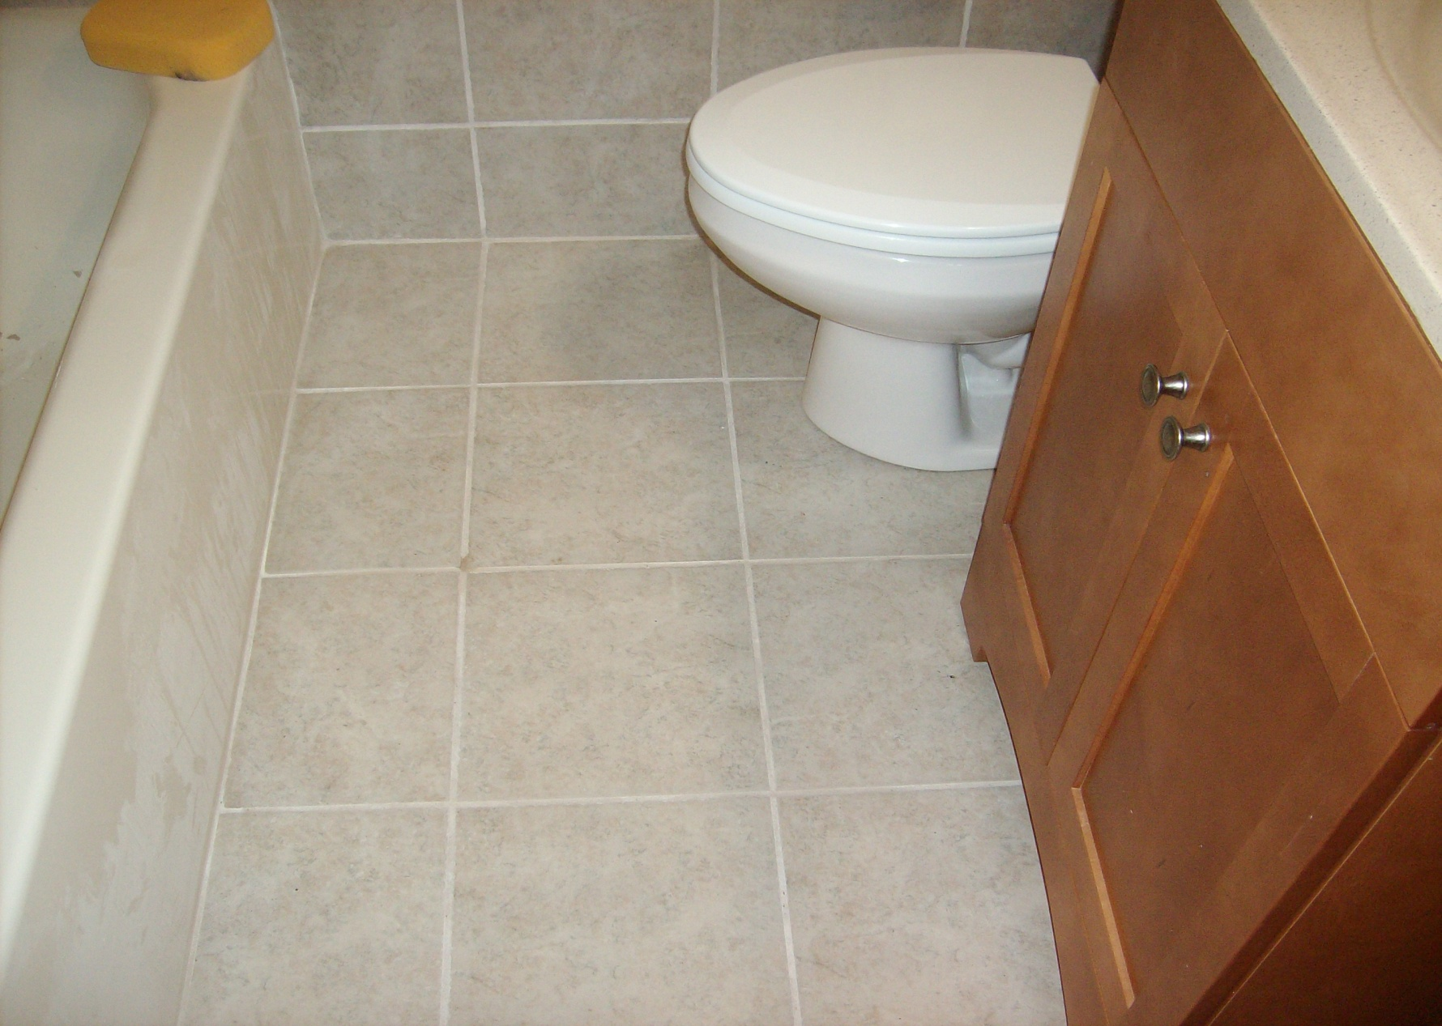
HALL BATH COMPLETE

Slide 13
TILE INSTALLATIONS

Slide 14
TILE INSTALLATIONS

Slide 15
TILE INSTALLATIONS

Slide 16
TILE INSTALLATIONS

Slide 17
TILE INSTALLATIONS

Slide 18
DOORS

Slide 19
JP DESIGNS
EMAIL JPDESIGNS@FASTMAIL.FM
WEBSITE WWW.JAMESPRINGLEDESIGNS.WEBS.COM
352-256-7433
YOUR ONE STOP SOURCE

